Slide 1
Prevention OLLI 2014
Kenneth Brummel-Smith, MD
Charlotte Edwards Maguire Professor of Geriatrics
Florida State University College of Medicine

Slide 2
Principles of Prevention
The condition must cause substantial illness (morbidity) or death (mortality)
The test should be accurate
Sensitivity (low false positives)
Specificity (low false negatives)
The condition should be common
The condition should have a long time when it is asymptomatic (time to benefit)

Slide 3
Principles of Prevention
The disease should have a treatment that improves outcomes
The screening test should have a reasonable cost and risk (all costs)
The test should be acceptable to the patient and society

Slide 4
Levels of Prevention
Primary prevention – preventing a condition from developing
Health promotion – diet, exercise, stress reduction
Specific protection– immunizations
Secondary prevention – preventing an asymptomatic disease from becoming active
Tertiary prevention – limiting disability caused by a disease

Slide 5
Caveats Regarding Screening
Be aware of who is making the recommendation
Generalists versus specialists
Vested interest in the procedure
Role of advocacy groups
Politics versus science
Fear of disease/belief in one’s choices

Slide 6
US Preventive Services Task Force
National experts in prevention and primary care
No subspecialists
Volunteer, not paid
Strict restrictions on payments from drug companies
http://www.uspreventiveservicestaskforce.org
App – AHRQ ePSS

Slide 7
USPSTF Recommendations
Counseling
Preventive Interventions
Screening
Levels of recommendation
A – recommended, substantial benefit
B – recommended, moderate benefit
C – small or limited benefit
D – NOT recommended, harmful
I – insufficient evidence

Slide 8
Recommended Screening
Consider screening for:
Hypertension
Breast and colorectal cancer
Obesity or malnutrition
Alcoholism
Vision and hearing deficits
Osteoporosis
Functional status

Slide 9
Controversies in Screening
When to stop?
Who shouldn’t be screened?
Impact of performance standards that are not geriatric sensitive
Blood pressure
A1C
Cholesterol
Use of incidental findings to “screen”

Slide 10
Life Expectancy Guides Decisions
JAMA, 2001; 285:2751

Slide 11
Life Expectancy Guides Decisions

Slide 12
When to Stop Screening?
When you don’t want it done!
“Benefit” is inherently personal
When life expectancy is shorter than the lead time benefit
Most screening interventions have a 5-7 year lead time benefit
When evidence shows it is not beneficial
PSA testing

Slide 13
The Burden of Screening
Fecal occult blood testing in 212 veterans with + FOBT, followed for 7 years. Mean age 76
Separated subjects into 3 groups:
Best life expectancy
Average life expectancy
Worst life expectancy
Definitions:
Benefit – found a polyp or cancer and lived at least 5 years
Burden – found something but died in less than 5 years, found nothing, did not have a colonoscopy
Kistler CE, Arch Intern Med, 2011; 171(15), 1344-1351
Notes:
Charlson index used to calculate life expectancy

Slide 14
The Burden of Screening
100
90
80
70
%
60
50
40
30
20
10
Benefits
Burdens

Slide 15
High Blood Pressure
Method
Check blood pressure at least annually
Rationale
Prevalence ↑ with advancing age
Treatment of hypertension ↓ morbidity & mortality from heart failure, heart attacks, and stroke
New Goal – less than 150/90 (JNC8)
USPSTF Grade - A

Slide 16
Breast Cancer
Methods
Consider Mammography if life expectancy is greater than 7 years
Rationale
No compelling evidence that BSE ↓ breast cancer morbidity & mortality – USPSTF – Grade D
USPSTF Grade - I

Slide 17
MAMMOGRAPHY RECOMMENDATIONS
Organization | Frequency | Until Age:
USPSTF, Canadian Task Force | Biennial | 74
American College of Physicians | Biennial | 74
American Geriatrics Society | Every 2–3 years | 85
Medicare covers annual screening mammograms

Slide 18
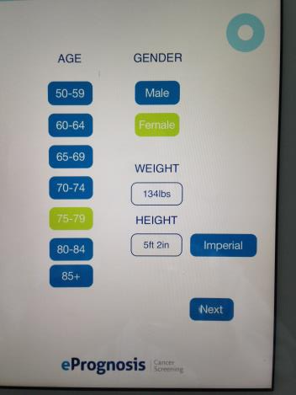
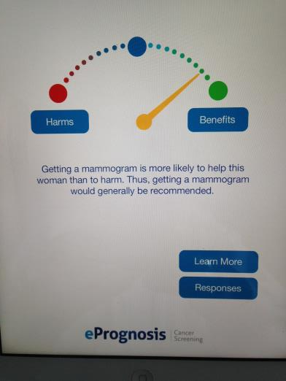
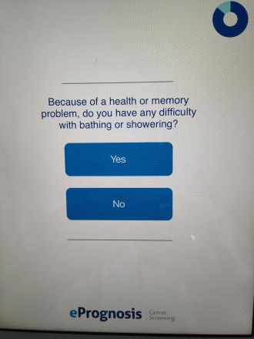
ePrognosis: Cancer Screening App

Slide 19
COLORECTAL CANCER
USPSTF recommends screening to age 75 (A)
FOBT or sigmoidoscopy every 5 years starting at age 65 (if not performed within previous 5 years)
Only if willing to undergo follow-up (i.e., colonoscopy)
One-time colonoscopy at age 65 (if not performed within previous 10 years) and every 10 years thereafter
Only with active life expectancy of 5 years or greater
Medicare covers annual FOBT, biennial sigmoidoscopy, colonoscopy every 10 years
Notes:
50-60% of patients do not undergo colonoscopy after a positive FOBT

Slide 20
CERVICAL CANCER
Not Recommended (USPSTF – Grade D)
Cut-off after age 65 with history of normal smears or after 2 normal smears 1 year apart
Biannual pelvic exam may be beneficial
Medicare covers Pap smear and pelvic exam every 2 years

Slide 21
OBESITY & MALNUTRITION
Method
Measure weight & height routinely
Calculate BMI: kg/m²
Definitions
Obesity defined as BMI > 28
Malnutrition defined as unintended weight loss of ≥10 lbs in 6 months
USPSTF Grade – B (obesity)

Slide 22
Cholesterol
USPSTF recommends screening older men for abnormalities:
Low-density lipoprotein ≥ 130 mg/dL
High-density lipoprotein ≤ 35 mg/dL
Triglycerides ≥ 200 mg/dL
Older women with increased risk factors should also be screened
Optimal interval is uncertain
No screening if life expectancy <5 years
USPSTF Grade - A

Slide 23
Cholesterol
Correcting lipid abnormalities ↓ risk of recurrence in older adults with prior heart attack or angina
No evidence of benefit of screening in women in absence of heart disease with few risk factors (USPSTF – Grade C)
Benefit of screening >75 y/o men with no risk factors is controversial

Slide 24
The Best Risk Calculator
http://bestsciencemedicine.com/chd/calc2.html

Slide 26
Osteoporosis
Start at age 65 in women (USPSTF – B)
Optimal interval for rescreening is unknown
Use the FRAX tool to determine 10-year fracture risk
DEXA scanning is the gold standard
Other methods are not recommended
Osteoporosis screening in men is controversial (USPSTF – I)

Slide 27
http://www.shef.ac.uk/FRAX/tool.aspx

Slide 28
Abdominal Aortic Anuerysm
USPSTF recommends one-time screening male smokers age 65-75 (Grade B)
Screening after that controversial
Make decision based on life expectancy and patient’s willingness to pursue work-up and intervention
Angiogram
Stent
Graft

Slide 29
Depression Screening
USPSTF recommends screening when supports are available for follow-up
Optimal interval is unknown
Various methods available
PHQ-2
In the last 2 weeks, have you been bothered by feeling sad, blue or depressed?
In the last 2 weeks, have you lost interest or pleasure in normal activities?
USPSTF Grade - B

Slide 30
Hearing & Vision
Vision: use Snellen chart routinely to detect uncorrected refractive errors, glaucoma, cataracts, macular degeneration
Hearing: question routinely to detect hearing loss; provide information about hearing aids

Slide 31
Counseling
All older adults should be counseled at least annually about:
Diet (USPSTF -B)
Physical activity (USPSTF -I)
Safety and injury prevention(USPSTF -I)
Smoking cessation (USPSTF -A)
Dental care

Slide 32
Mediterranean Diet
Large intake of fruits, vegetables, legumes and cereals (mostly unprocessed)
Moderate amounts of alcohol
Small amounts of red meats
Moderate to large amounts of fish
Small amounts of saturated fats and high amounts of unsaturated fats
Small to moderate amounts of dairy products
JAMA 2004:292:1433-1439

Slide 33
Other Preventive Services?
Preventive services are recommended by specialty organizations for the following, even though evidence for effectiveness is lacking:
Diabetes mellitus
Thyroid disease
Prostate cancer
Skin cancer

Slide 34
PREVENTIVE SERVICES NOT INDICATED IN OLDER ADULTS
Screening for Specific Diseases
Bladder cancer
Lung cancer
Hematologic malignancies
Ovarian cancer
Pancreatic cancer
Prostate cancer
Routine Laboratory Testing
Annual CBC, blood chemistry
Annual chest x-ray, ECG

Slide 35
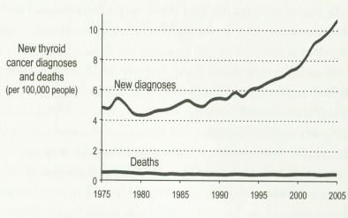
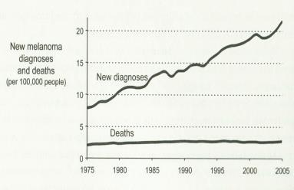
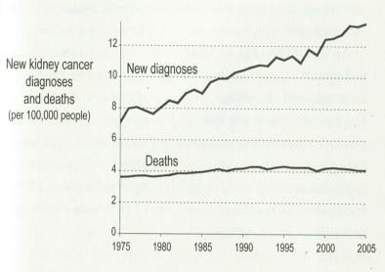
Cancers Overdiagnosed?
Thyroid
Melanoma
Kidney
Overdiagnosed

Slide 36
Resources for Screening
USPSTF
Online
AHRQ ePSS app
ePrognosis: Cancer Screening
Overdiagnosed, Gilbert Welch, Beacon Press, Boston, 2011

Slide 37
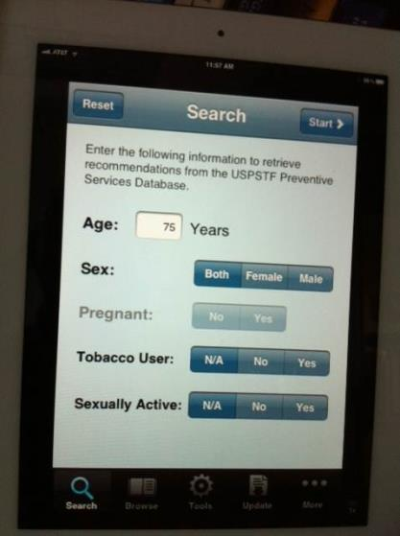
ePSS

Slide 39
References
Spalding MC. Geriatric screening and preventive care. Am Fam Physician 2008;78:206-215
Flaherty JH, et al. The development of outpatient clinical glidepaths. JAGS 2002;50:1892-1893
Welch, G. Over-diagnosed: Making people sick in the pursuit of health. Beacon Press, Boston, 2011
Geriatrics at Your Fingertips, book or App
ePrognosis: Cancer Screening, Apple App Store
AHRQ ePSS, Apple App Store
FRAX, Apple App Store

